Slide 1

Teaching a New Dog Old Tricks: Surveying FIDO2 Deployments
TRISS
October 29, 2025
Geoff Robinson

Slide 2
Introduction
Teaching a New Dog Old Tricks: Surveying FIDO2/WebAuthn Deployments
WebAuthn and Passkeys - elements of the FIDO2 passwordless authentication scheme -- continue to become more commonplace now that they are supported by all of the major browsers.
This new dog promises to be "more secure" by avoiding the pitfalls of passwords, but the huge variety of WebAuthn server implementations are relatively untested. And we know that even if the protocol is bulletproof, a given deployment can be anything but.
As pen testers, what tricks can we still use to spoof authentication or elevate privileges?

Slide 3

Introduction - Geoff
Who am I?
Geoff Robinson
Principal Consultant, Cybersecurity Assessment
Joined ivision via acquisition in 2021
In current role since 2017 (8 years)
Previously worked as a software engineer (15 years)
Very Chicago
BS Computer Engineering, University of Illinois, Urbana-Champaign (2002)
MBA, University of Chicago
“Yes” to neighborhood street fests
“No” to ketchup

Slide 4

Introduction
Who am I?
Geoff Robinson
Principal Consultant, Cybersecurity Assessment
Joined ivision via acquisition in 2021
In this role since 2017 (8 years)
Previously worked as a software engineer (15 years)
Very Chicago
BS Computer Engineering, University of Illinois, Urbana-Champaign (2002!)
MBA, University of Chicago
“Yes” to neighborhood street fests
“No” to ketchup

Slide 5
Introduction - ivision
Security Assessment
Enterprise Penetration Testing & Red Teaming
Carrier & OEM Device Security
Proactively find flaws before they can be exposed or exploited.
Enable frictionless product launches and ongoing protection of customer data.
Application Security Assessment
Product Security Engineering / DevSecOps
We conduct threat-driven testing to protect your digital revenue streams.
Preserve velocity, cost and time by building security into your software.
https://ivision.com/technology-solutions/security/assessment/

Slide 6
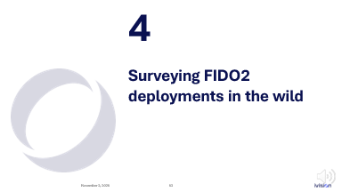
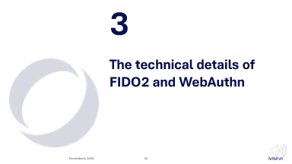
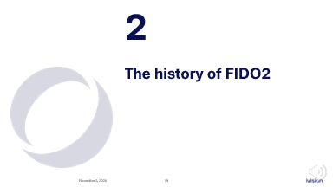
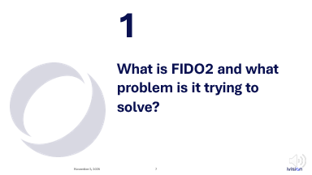
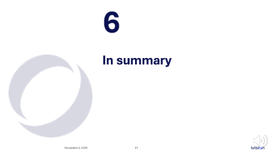
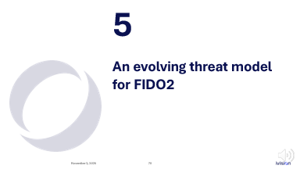

Slide 7
What is FIDO2 and what problem is it trying to solve?
1

Slide 8
What is FIDO2 and what problem is it trying to solve?
What’s the problem?
Passwords are the problem.
Notes:
https://fidoalliance.org/

Slide 9
What is FIDO2 and what problem is it trying to solve?
What’s the problem?
Passwords are the problem.
Humans create terrible passwords
Guessable ( Fall2025! )
Password reuse across accounts
Phishing and social engineering
Passwords can be intercepted in transit
Stored password hashes on servers can be compromised and cracked
Help desks spend a lot of time supporting password issues
Notes:
https://fidoalliance.org/

Slide 10
What is FIDO2 and what problem is it trying to solve?
What’s the problem?
credential abuse (stolen or weak passwords) was the leading initial attack vector, accounting for 22% of data breaches
60% of breaches involved a human element (e.g. phishing)
In 2024, more than 2.8 billion passwords from compromised server-side databases – hashed or otherwise – were posted in criminal forums
Notes:
https://fidoalliance.org/

Slide 11
What is FIDO2 and what problem is it trying to solve?
What’s the solution?
Passkeys are the solution.
Notes:
https://fidoalliance.org/

Slide 12
What is FIDO2 and what problem is it trying to solve?
What’s the solution?
FIDO2 authentication options
Passwordless authentication
Strong single factor authentication using a hardware authenticator, eliminates the need for weak password-based authentication.
Two factor authentication
Strong two factor authentication using a hardware authenticator as an extra layer of protection beyond a password.
Multi-factor authentication
Strong multi-factor authentication using a hardware authenticator and a PIN or biometric, to meet high assurance requirements such as needed for financial transactions and ordering a prescription.
Notes:
https://fidoalliance.org/

Slide 13
What is FIDO2 and what problem is it trying to solve?
What’s the solution?
FIDO2 authentication options
Passwordless authentication
Strong single factor authentication using a hardware authenticator, eliminates the need for weak password-based authentication.
Two factor authentication
Strong two factor authentication using a hardware authenticator as an extra layer of protection beyond a password.
Multi-factor authentication
Strong multi-factor authentication using a hardware authenticator and a PIN or biometric, to meet high assurance requirements such as needed for financial transactions and ordering a prescription.
Notes:
https://fidoalliance.org/

Slide 14
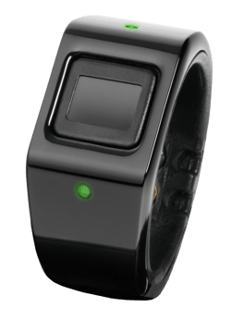
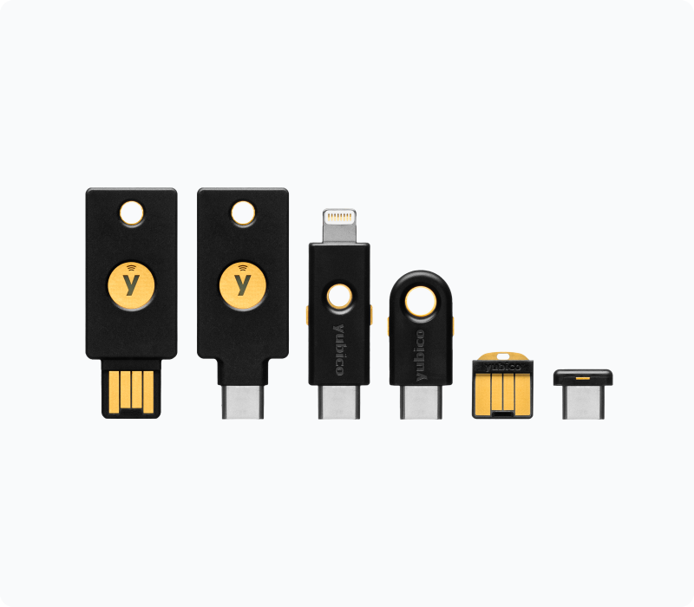
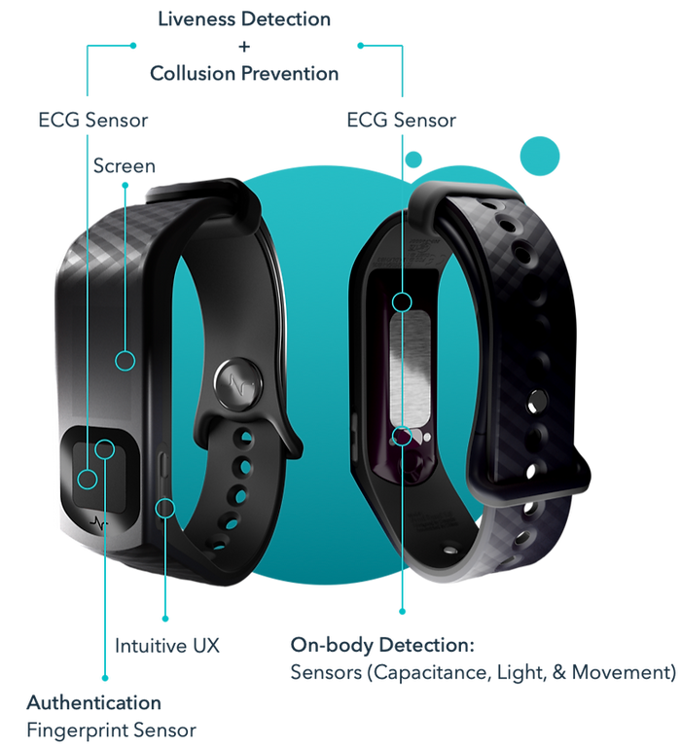
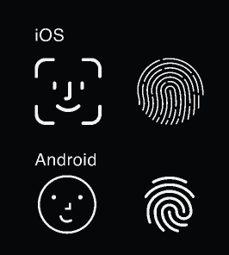
What is FIDO2 and what problem is it trying to solve?
What’s the solution?
FIDO2 passwordless authentication relies on cryptographic algorithms to generate a public-private key
The key pair is used to perform user authentication directly on an end user’s device, whether a desktop computer, laptop, mobile phone, or security key
A passkey can be bound to a single user device or automatically synced across a user’s multiple devices through a cloud service
Notes:
https://fidoalliance.org/

Slide 15
What is FIDO2 and what problem is it trying to solve?
What’s the benefit?
FIDO2’s main benefits are:
enhanced security against credential theft
improved privacy by keeping personal data on the user's device
a simpler login experience that eliminates the need to remember complex passwords

Slide 16
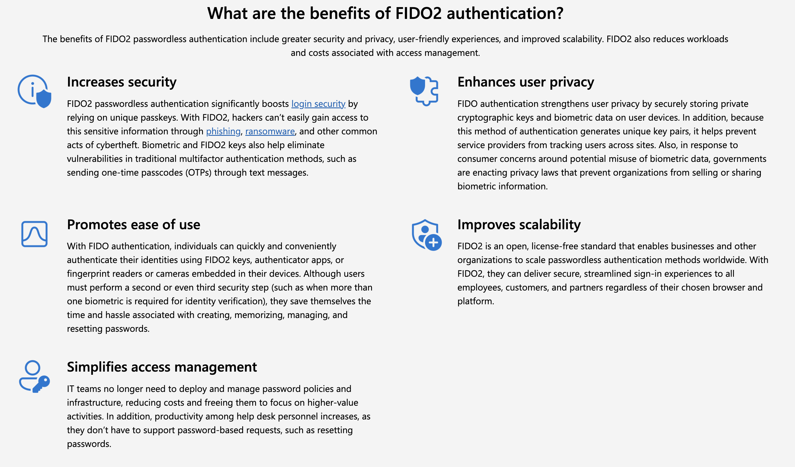

What is FIDO2 and what problem is it trying to solve?
What’s the benefit?
https://www.microsoft.com/en-us/security/business/security-101/what-is-fido2

Slide 17
What is FIDO2 and what problem is it trying to solve?
What’s the benefit?
Are these claims too good to be true?

Slide 18
What is FIDO2 and what problem is it trying to solve?
Spoilers
Key Takeaways
FIDO2 was originally intended to support hardware authenticators with strong security guarantees
But these guarantees are being eroded in practice
This makes it easier (but maybe not easy) to steal passkeys
FIDO2 is not magic
Some of the same old security issues are still present
FIDO2 is complicated, which means implementors are going to make mistakes
Notes:
Re Implementors: Here I’m thinking about what run of the mill ecommerce sites are going to end up doing

Slide 19
The history of FIDO2
2

Slide 20
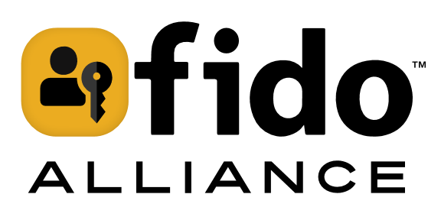
The history of FIDO2
FIDO2 (Fast IDentity Online 2) is an open authentication standard developed by the FIDO Alliance, an industry consortium of technology, commercial, and government organizations.
The FIDO Alliance was founded in 2013.
Founding members were Lenovo, PayPal, Nok Nok Labs, Validity Sensors, Infineon, Agnitio, Insyde Software, and NXP Semiconductors.
https://fidoalliance.org/

Slide 21

The history of FIDO2
FIDO2 (Fast IDentity Online 2) is an open authentication standard developed by the FIDO Alliance, an industry consortium of technology, commercial, and government organizations.
The FIDO Alliance was founded in 2013.
Founding members were Lenovo, PayPal, Nok Nok Labs, Validity Sensors, Infineon, Agnitio, Insyde Software, and NXP Semiconductors.
https://fidoalliance.org/
acquired in June 2025

Slide 22
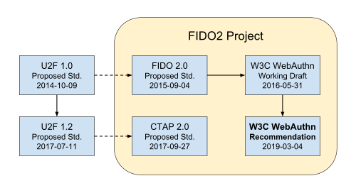
The history of FIDO2
At its core, FIDO2 consists of the W3C Web Authentication (WebAuthn) standard and the FIDO Client to Authenticator Protocol 2 (CTAP2). The overall protocol architecture is defined via the Universal Authenticator Framework (UAF).
FIDO2 is based upon previous work done by the FIDO Alliance, in particular the Universal 2nd Factor (U2F) authentication standard.
The original standards were intended to work exclusively with hardware-based authenticators.
https://en.wikipedia.org/wiki/FIDO_Alliance

Slide 23
The history of FIDO2
WebAuthn browser support:
Browser | Earliest version with WebAuthn support | Date Released
Chrome | 67 | May 2018
Firefox | 60 | May 2018
Microsoft Edge | 18 | June 2018
Safari | 13 | June 2019

Slide 24

The history of FIDO2
WebAuthn at W3C:
March 2019
W3C Recommendation: WebAuthn Level 1 Standard published
April 2021
W3C Recommendation: WebAuthn Level 2 Standard published
April 2021
A Level 3 spec was first published as a working draft
Latest update January 2025

Slide 25

The history of FIDO2
I started working on FIDO2 with clients in 2021
Security assessment of a large scale, customer-facing passkey deployment for an enterprise
Early adopter
100+ million existing users
Comprehensive threat model
Penetration testing
Server-side authentication integration
Mobile app ecosystem /w FIDO2 SDK
Custom Android OS elements

Slide 26
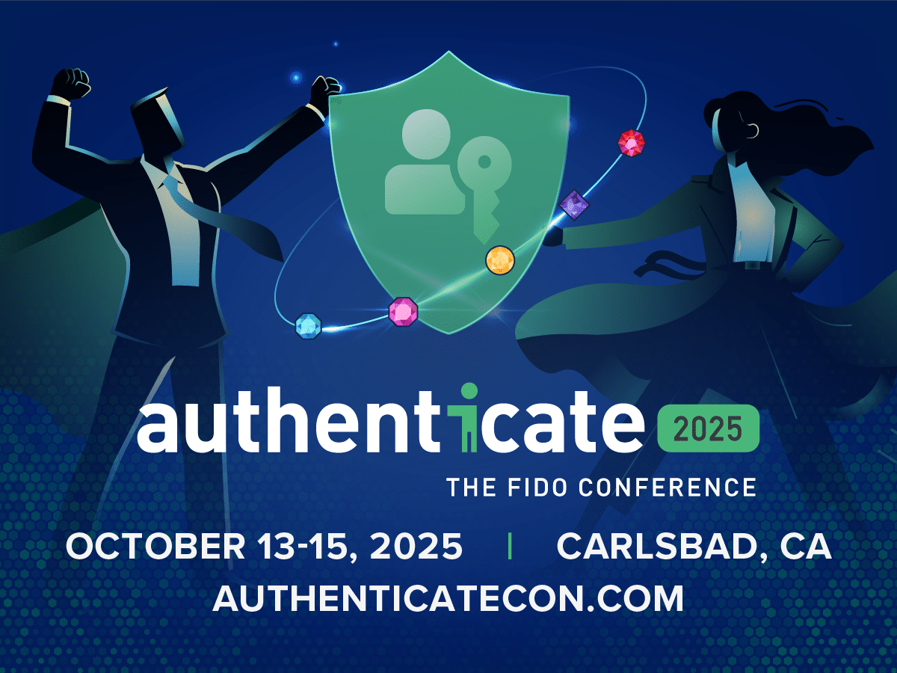
The history of FIDO2
This year, I’ve been working on keeping up!
WebAuthn has significant momentum
Passkeys have significant adoption
Standards and practices are rapidly evolving

Slide 27
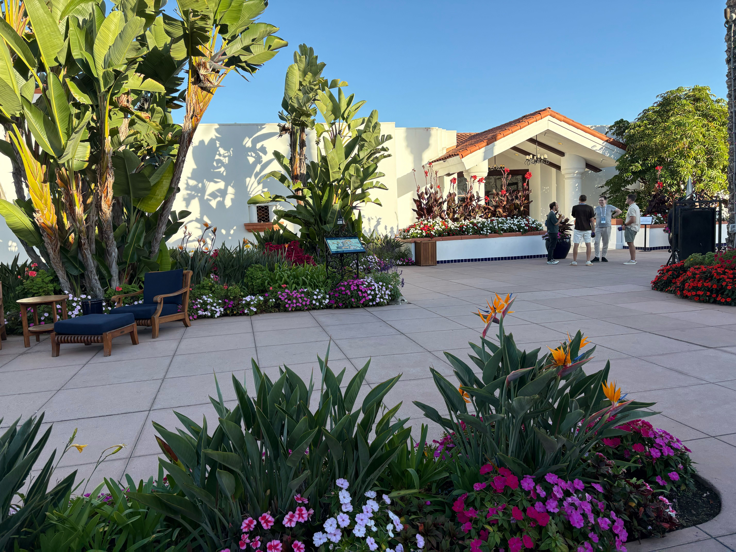
The history of FIDO2

Slide 28
The history of FIDO2
Passkey Index – October 2025

Slide 29
The history of FIDO2
Passkey Index – October 2025

Slide 30
The history of FIDO2
Passkey Index – October 2025

Slide 31
The history of FIDO2
Passkey Index – October 2025
Google reports that
1+ billion users
have signed in with a passkey

Slide 32
The history of FIDO2
Passkey Index – October 2025

Slide 33
The history of FIDO2
Passkey Index – October 2025

Slide 34
The history of FIDO2
Passkey Index – October 2025
Notes:
PREVIEW NOTE: A lot of this adoption has been at odds with the original intent of the FIDO design

Slide 35
The technical details of FIDO2 and WebAuthn
3

Slide 36
The technical details of FIDO2 and WebAuthn
Background
Asymmetric Cryptography
Public-private key pairs
The foundation of trust on the internet
HTTPS and TLS
Public Key Infrastructure (PKI) for Server Certificates
The first publicly proposed asymmetric cryptography was the Diffie-Hellman key exchange in 1976, followed by the RSA algorithm in 1977

Slide 37
The technical details of FIDO2 and WebAuthn
Background
Asymmetric Cryptography – key security properties (ha!):
Confidentiality
The public key can be used to encrypt a message
The message can be decrypted only by the holder of the private key
Authentication
The private key can be used to sign a message
The signature can be verified by anyone with the public key

Slide 38
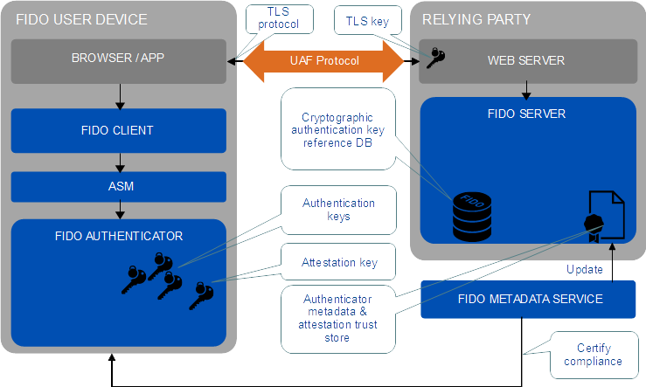
The technical details of FIDO2 and WebAuthn
Basic Model
FIDO UAF Architectural Overview v1.2 (20 October 2020)
https://fidoalliance.org/specifications/download/

Slide 39
The technical details of FIDO2 and WebAuthn
Basic Model
User Device
The device where the FIDO Client operates and from which the user initiates FIDO actions
User Agent
The user agent is a client application that is acting on behalf of a user in a client-server system. Examples of user agents include web browsers and mobile apps
FIDO Client
The software entity processing the UAF or U2F protocol messages on the User Device (e.g. password manager)
Authenticator Specific Module (ASM)
Software associated with a FIDO Authenticator that provides a uniform interface between the hardware and FIDO Client
Authenticator
An authentication entity which has related metadata
FIDO Technical Glossary (23 May 2022)
https://fidoalliance.org/specifications/download/

Slide 40
The technical details of FIDO2 and WebAuthn
Basic Model
Relying Party
A web site or other entity that directly authenticates users
FIDO Server
Server software deployed by relying party that meets UAF protocol server requirements
Metadata Service (MDS)
The service that provides Metadata Statements of Authenticators
https://fidoalliance.org/metadata/
FIDO Technical Glossary (23 May 2022)
https://fidoalliance.org/specifications/download/

Slide 41
The technical details of FIDO2 and WebAuthn
Basic Model
FIDO2 provides authentication using two different public-private key pairs
Attestation key
Authenticates the Authenticator
Private key is generated by device OEM and factory fused to a whole class of devices
Private key never leaves the device *
Public key is in the Metadata Service
Authentication key
Authenticates the User
Private key is generated and stored by the Authenticator during registration
Private key never leaves the device **
Public key is sent to Relying Party
* Not all authenticators have strong guarantees on this
** This attribute continues to be relaxed

Slide 42
The technical details of FIDO2 and WebAuthn
Basic Model
FIDO UAF Architectural Overview v1.2 (20 October 2020)
https://fidoalliance.org/specifications/download/
Notes:
This slide is intentionally repeated

Slide 43
The technical details of FIDO2 and WebAuthn
Basic Model
There are just three flows defined in the protocol
Device registration
Device deregistration
Authentication
UAF protocol message payloads are in a JSON format end-to-end (FIDO Server to the ASM)
FIDO Technical Glossary (23 May 2022)
https://fidoalliance.org/specifications/download/

Slide 44
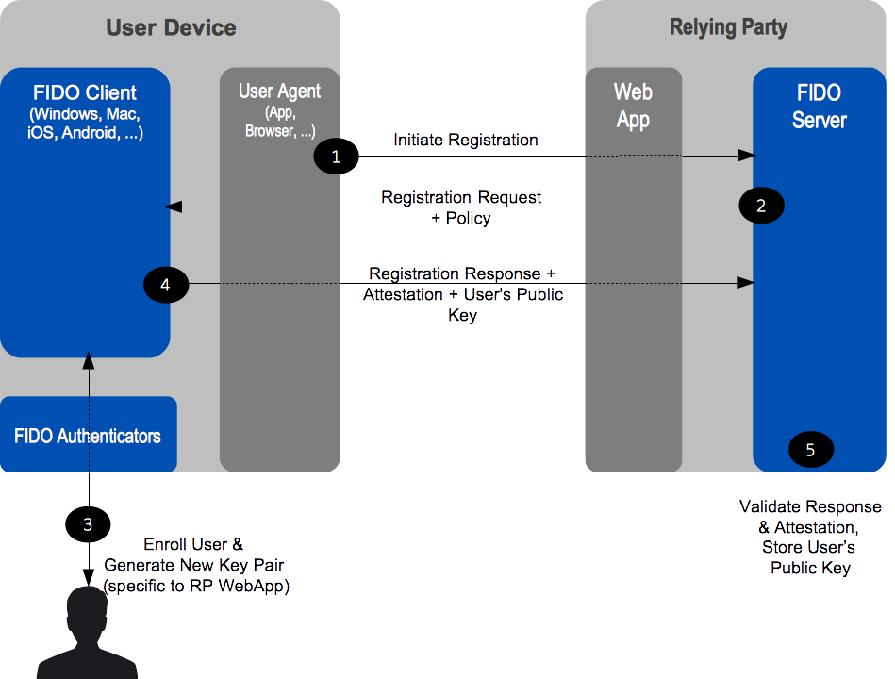
The technical details of FIDO2 and WebAuthn
Device Registration
FIDO UAF Architectural Overview v1.2 (20 October 2020)
https://fidoalliance.org/specifications/download/

Slide 45
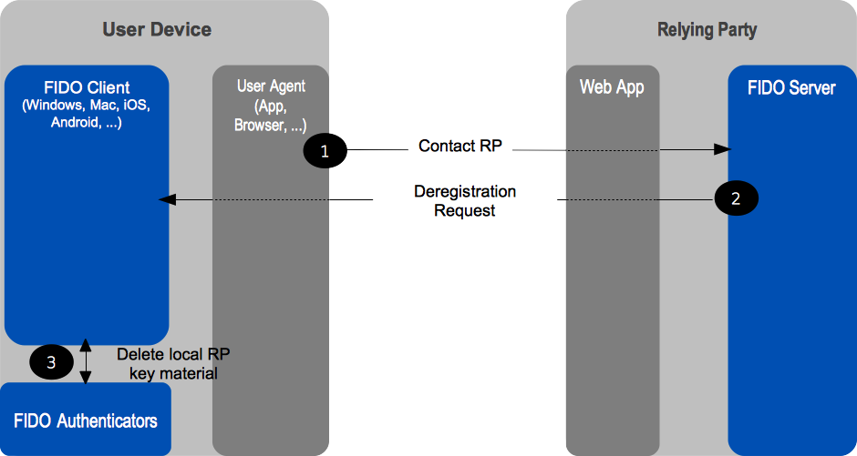
The technical details of FIDO2 and WebAuthn
Device Deregistration
FIDO UAF Architectural Overview v1.2 (20 October 2020)
https://fidoalliance.org/specifications/download/

Slide 46
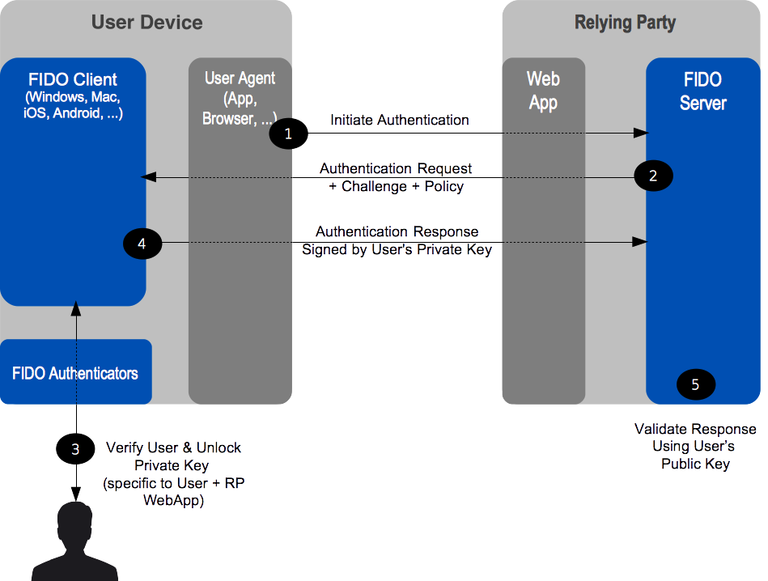
The technical details of FIDO2 and WebAuthn
Authentication
FIDO UAF Architectural Overview v1.2 (20 October 2020)
https://fidoalliance.org/specifications/download/

Slide 47
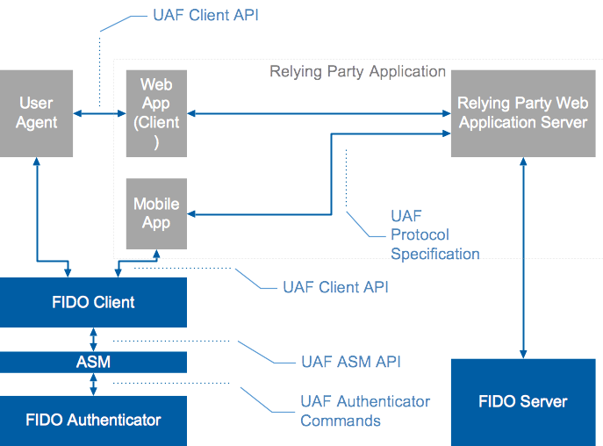
The technical details of FIDO2 and WebAuthn
Authentication
FIDO UAF Architectural Overview v1.2 (20 October 2020)
https://fidoalliance.org/specifications/download/

Slide 48
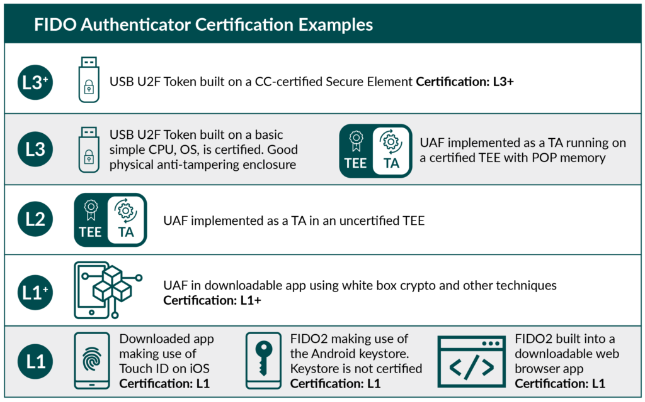
The technical details of FIDO2 and WebAuthn
Metadata Service (MDS)
The MDS tracks the attributes of a diverse ecosystem of Authenticators (e.g. fingerprint biometrics)
MDS is used by Relying Parties to verify that Authenticators meet certain certifications, as well as leverage security issue notifications
Relying Parties are expected to configure their FIDO Server to accept or reject Users’ Authenticator choices based on this criteria
User Authentication – Certified Authenticator Levels
https://fidoalliance.org/certification/authenticator-certification-levels/

Slide 49
The technical details of FIDO2 and WebAuthn
WebAuthn
Web Authentication (WebAuthn) is the web standard published by the World Wide Web Consortium (W3C)
The central interface is the navigator.credentials JavaScript property, using the PublicKeyCredential object via three main functions:
create(): create a new credential.
store(): store a new credential locally.
get(): retrieve a credential, which can then be used to log a user in.
Mozilla Developer Docs:
https://developer.mozilla.org/en-US/docs/Web/API/Credential_Management_API
https://developer.mozilla.org/en-US/docs/Web/API/Web_Authentication_API

Slide 50
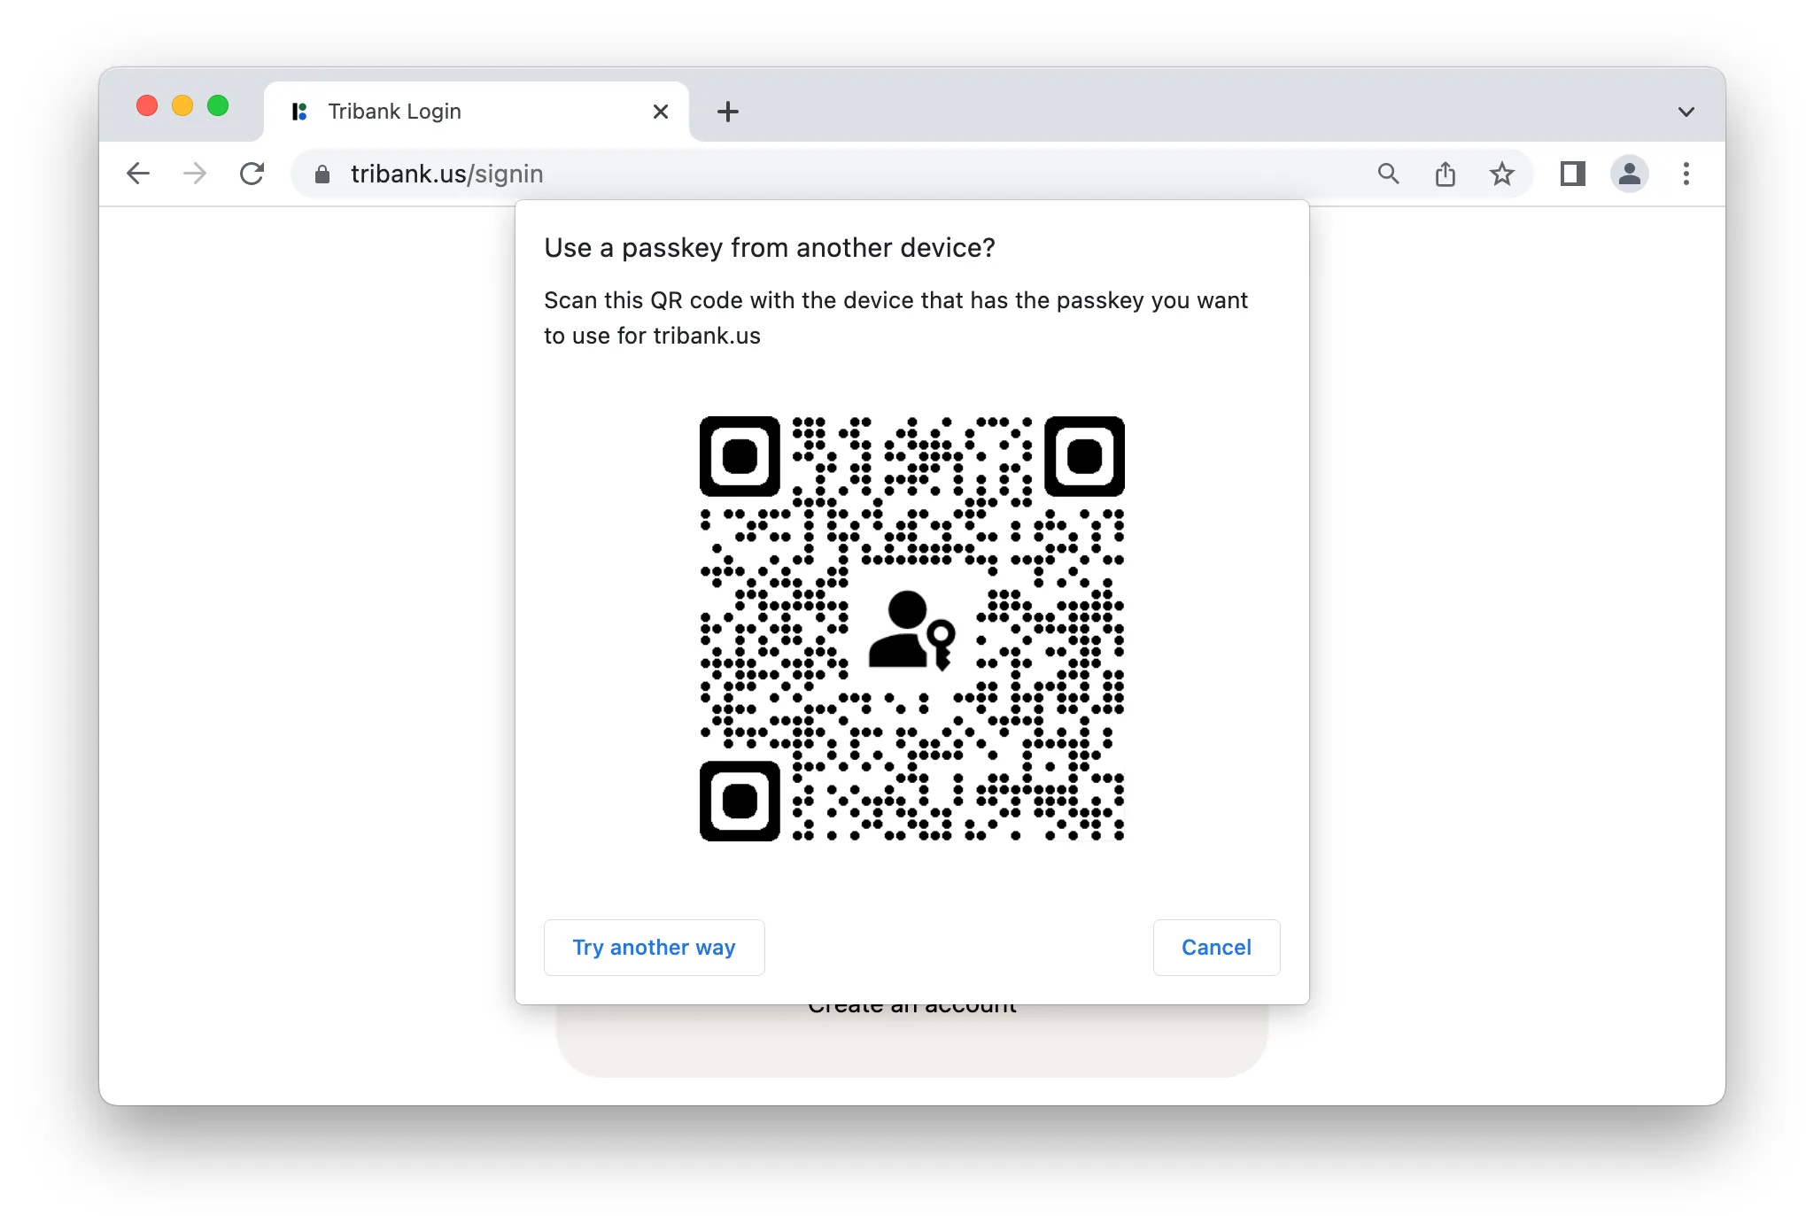
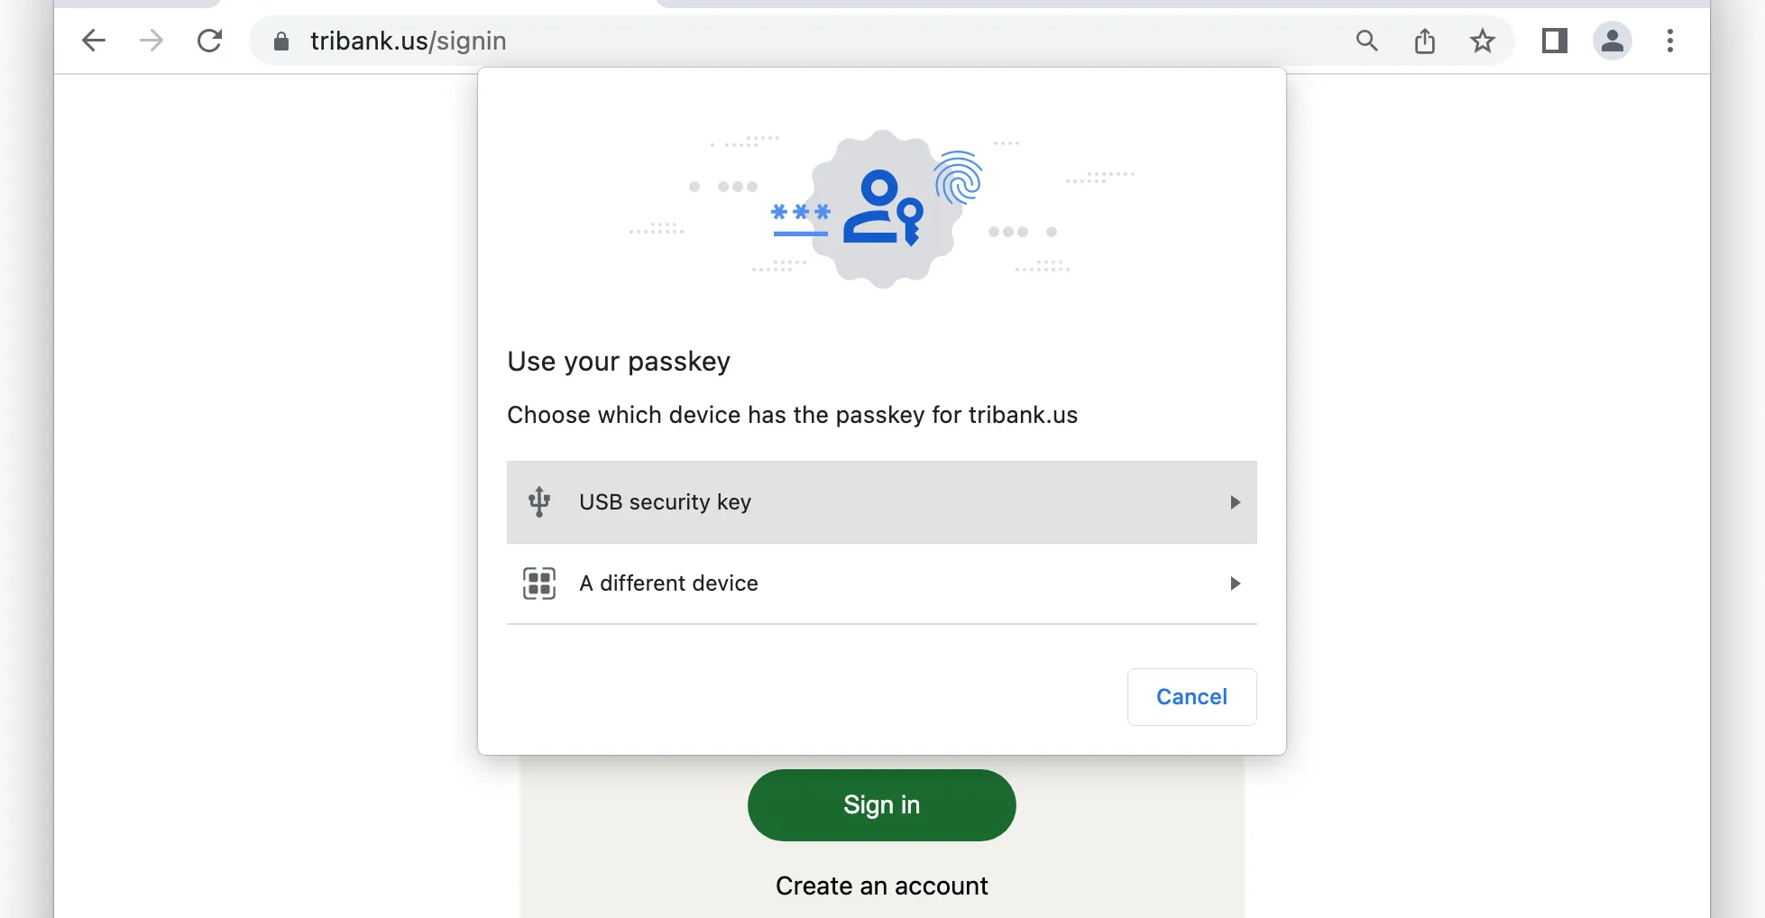
The technical details of FIDO2 and WebAuthn
WebAuthn

Slide 51
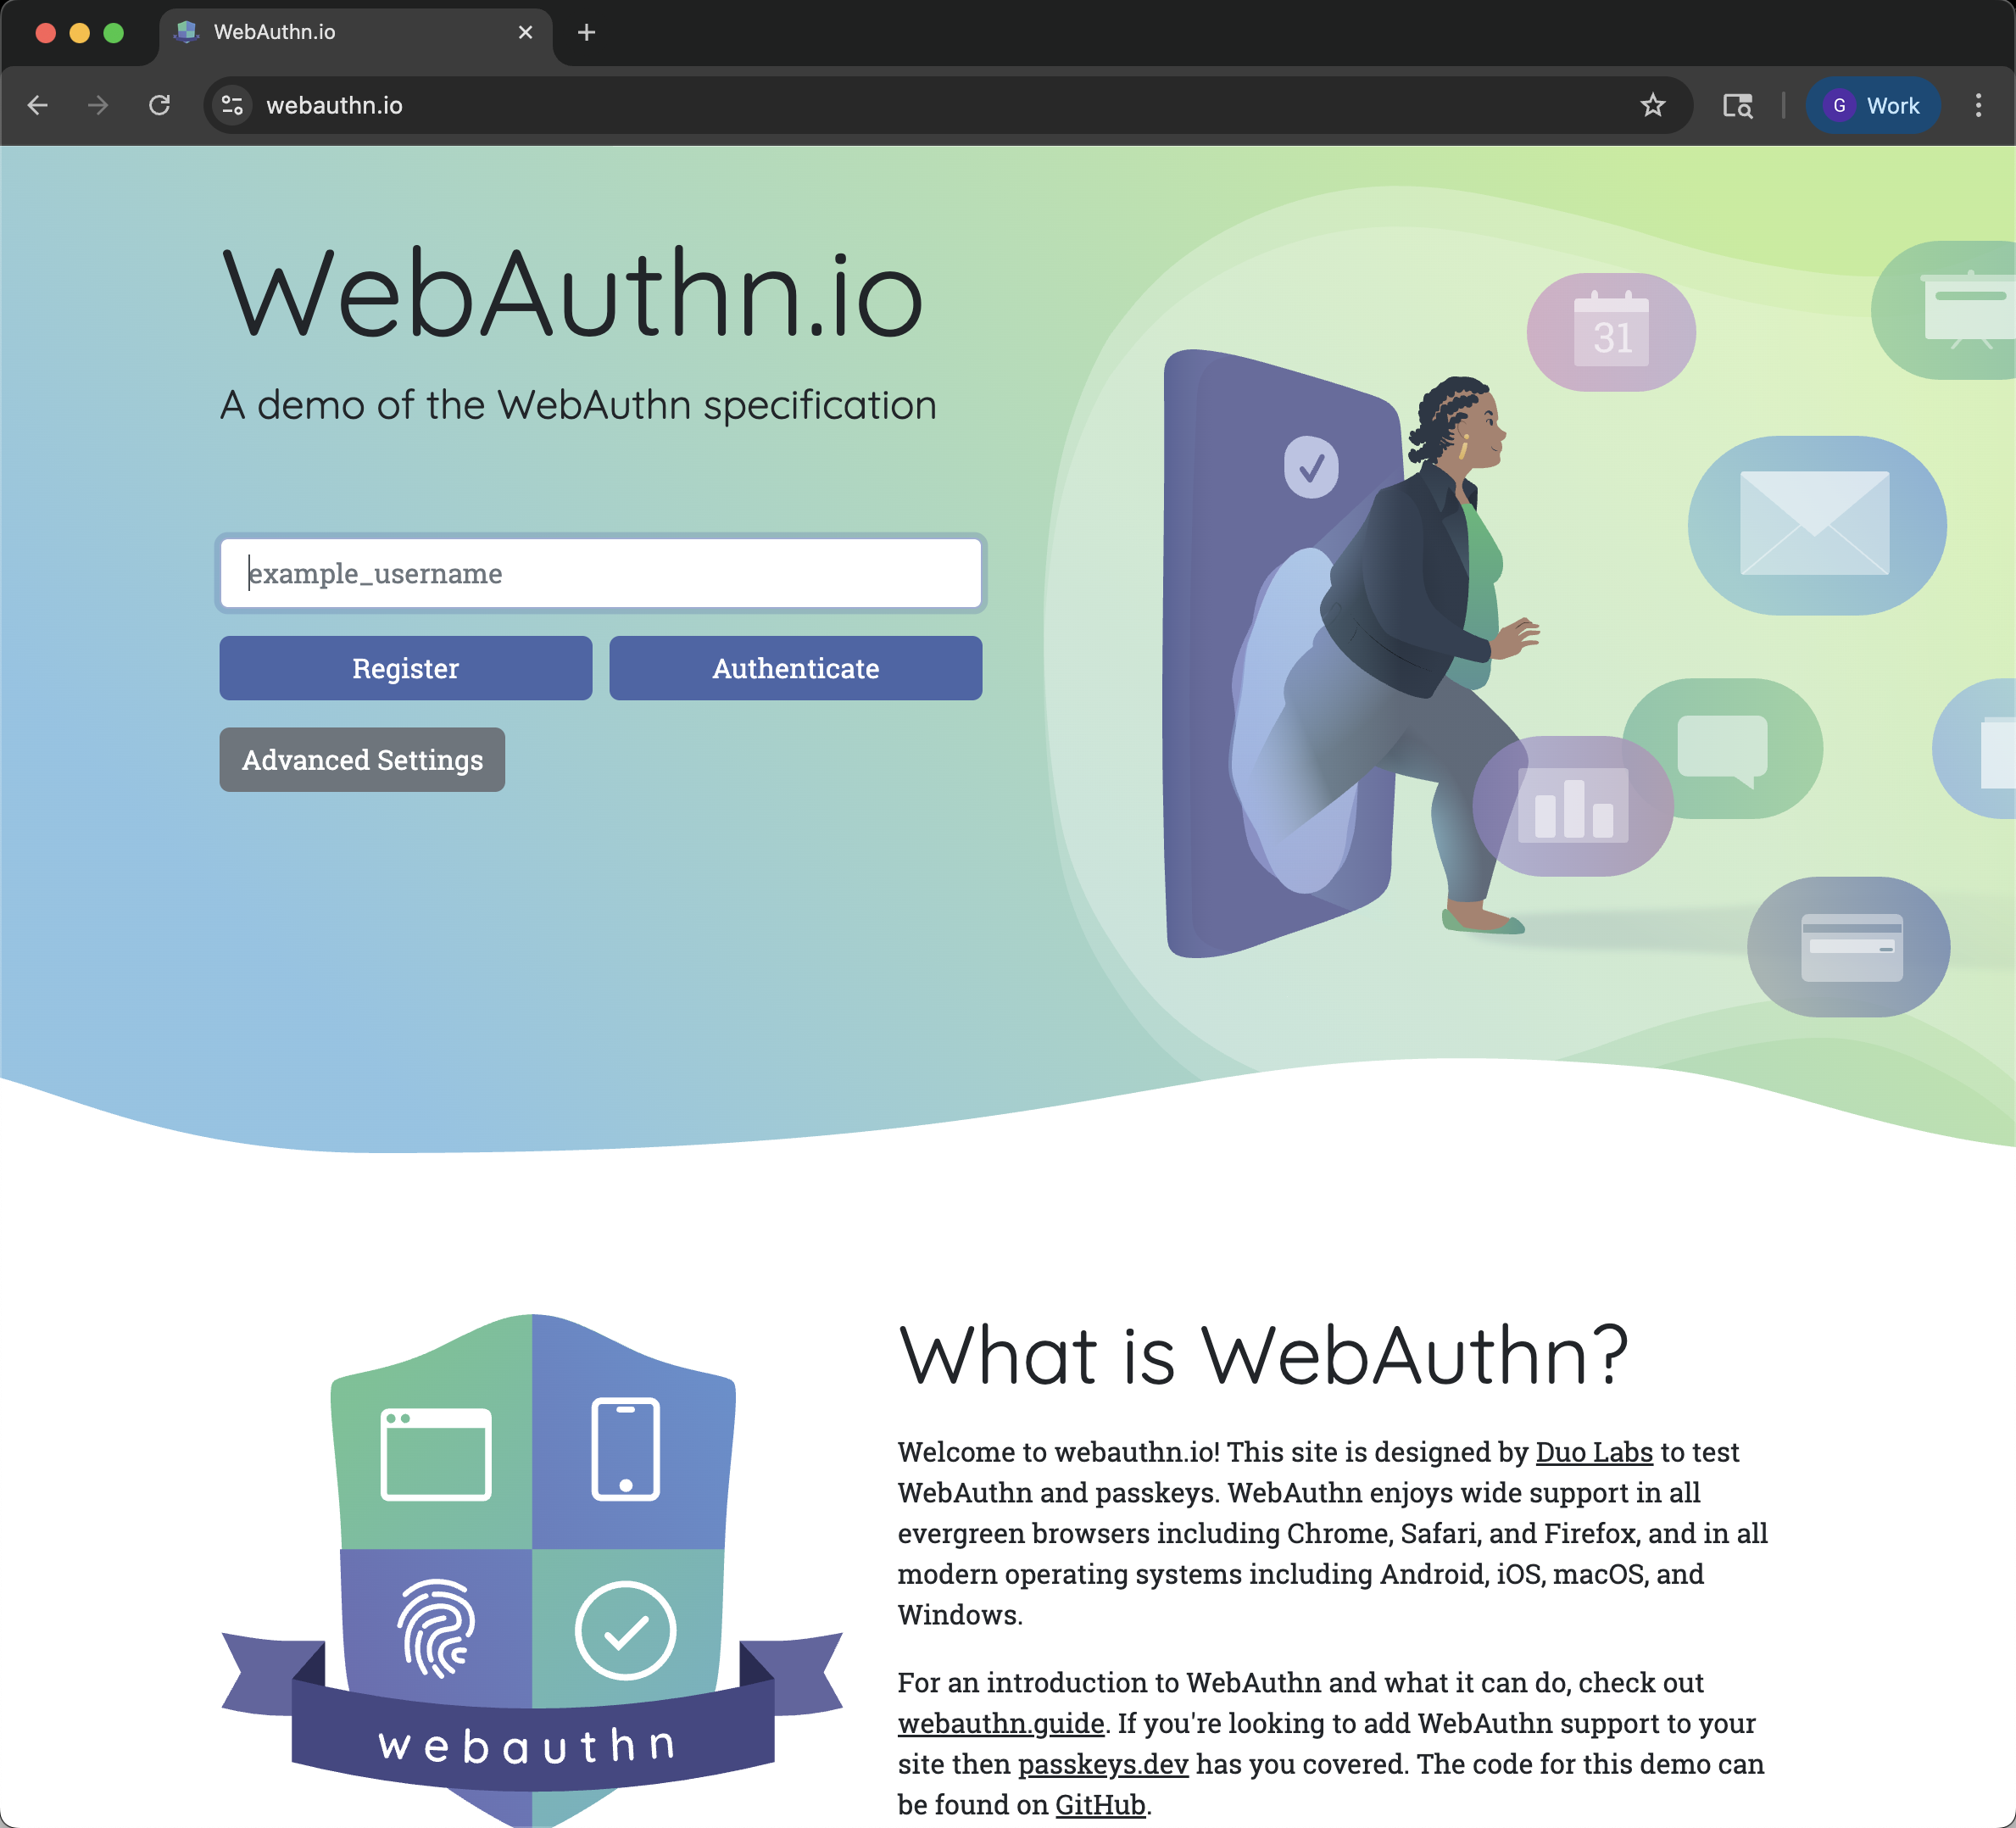
The technical details of FIDO2 and WebAuthn
WebAuthn
This is a great resource:
https://webauthn.io/

Slide 52
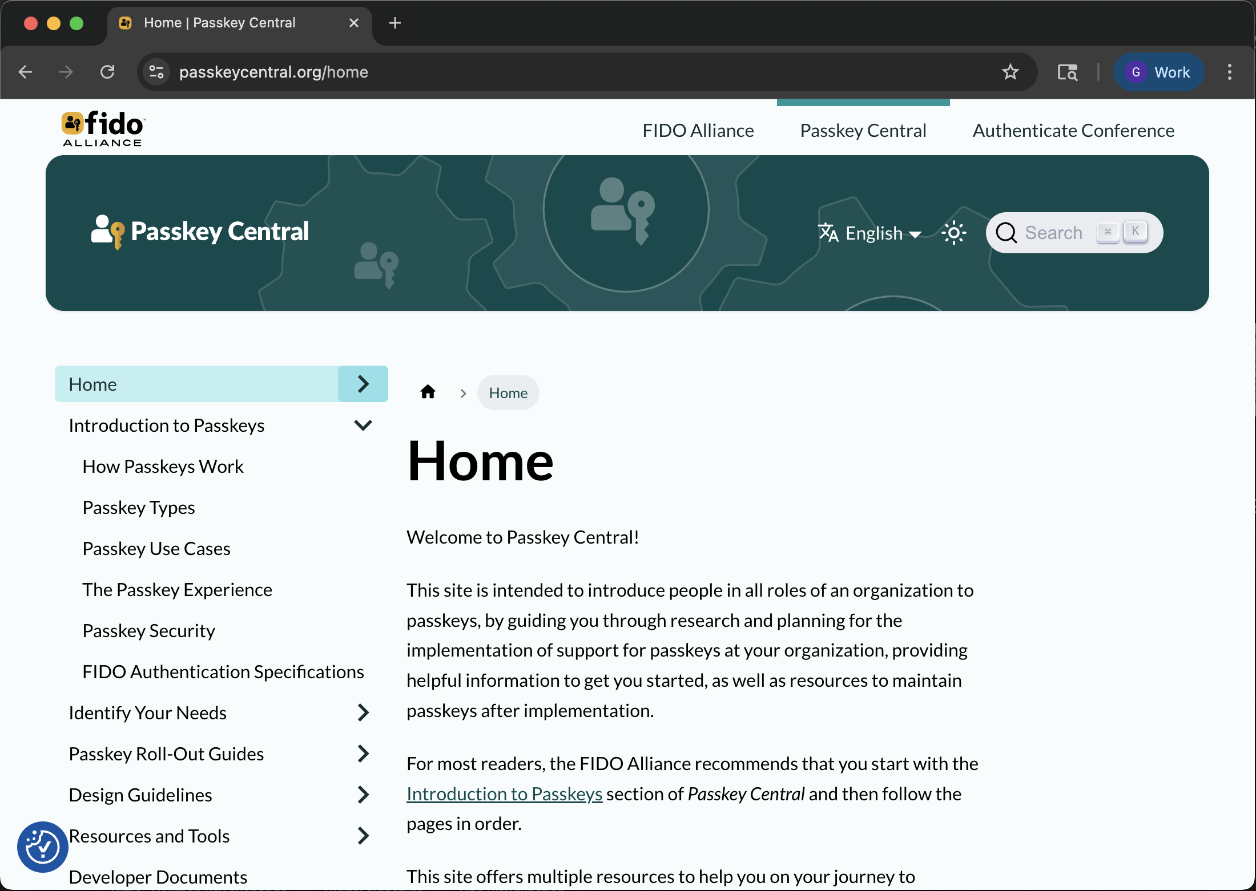
The technical details of FIDO2 and WebAuthn
This is a great resource:
https://www.passkeycentral.org/home/

Slide 53
Surveying FIDO2 deployments in the wild
4

Slide 54
Surveying FIDO2 deployments in the wild
It’s 2025 and I want to know:
Who are the vendors in the passkey space and what are they building?
Who is using FIDO2 / WebAuthn?
How are they using FIDO2 / WebAuthn?

Slide 55
Surveying FIDO2 deployments in the wild
It’s 2025 and I want to know:
Who are the vendors in the passkey space and what are they building?
Who is using FIDO2 / WebAuthn?
How are they using FIDO2 / WebAuthn?
Are there security flaws?

Slide 56
Surveying FIDO2 deployments in the wild
Who are the vendors?
All of the major browsers support the WebAuthn spec through the Credentials API and Web Authentication API
Except for Android WebViews
Desktop
Chrome
Edge
Firefox
Opera
Safari
Mobile
Chrome Android
Firefox for Android
Opera Android
Safari on iOS
Samsung Internet
WebView Android
WebView on iOS
Mozilla Developer Docs:
https://developer.mozilla.org/en-US/docs/Web/API/Credential_Management_API
https://developer.mozilla.org/en-US/docs/Web/API/Web_Authentication_API

Slide 57

Surveying FIDO2 deployments in the wild
Who are the vendors?
Authenticator OEMs
Enterprise Identity Solution Providers
Password Managers
Platforms
Act as both authenticator and password manager
Apple *OS, Google Android, Microsoft Windows, Samsung IoT
Linux

Slide 58
Surveying FIDO2 deployments in the wild
Who is using WebAuthn?
Big Tech
Apple, Google, Microsoft
Financial Services
Fraud prevention
Enterprises
Everyone else is just starting to notice passkeys

Slide 59
Surveying FIDO2 deployments in the wild
How are they using WebAuthn?
Active Research!
I am looking at how these vendors and enterprises are using passkeys.
Phase 1: Detailed fact finding
Phase 2: … ?
Phase 3: Profit Vulnerabilities

Slide 60
Surveying FIDO2 deployments in the wild
How are they using WebAuthn?
Phase 1: Detailed fact finding
Background research
Everything you’ve seen today so far

Slide 61
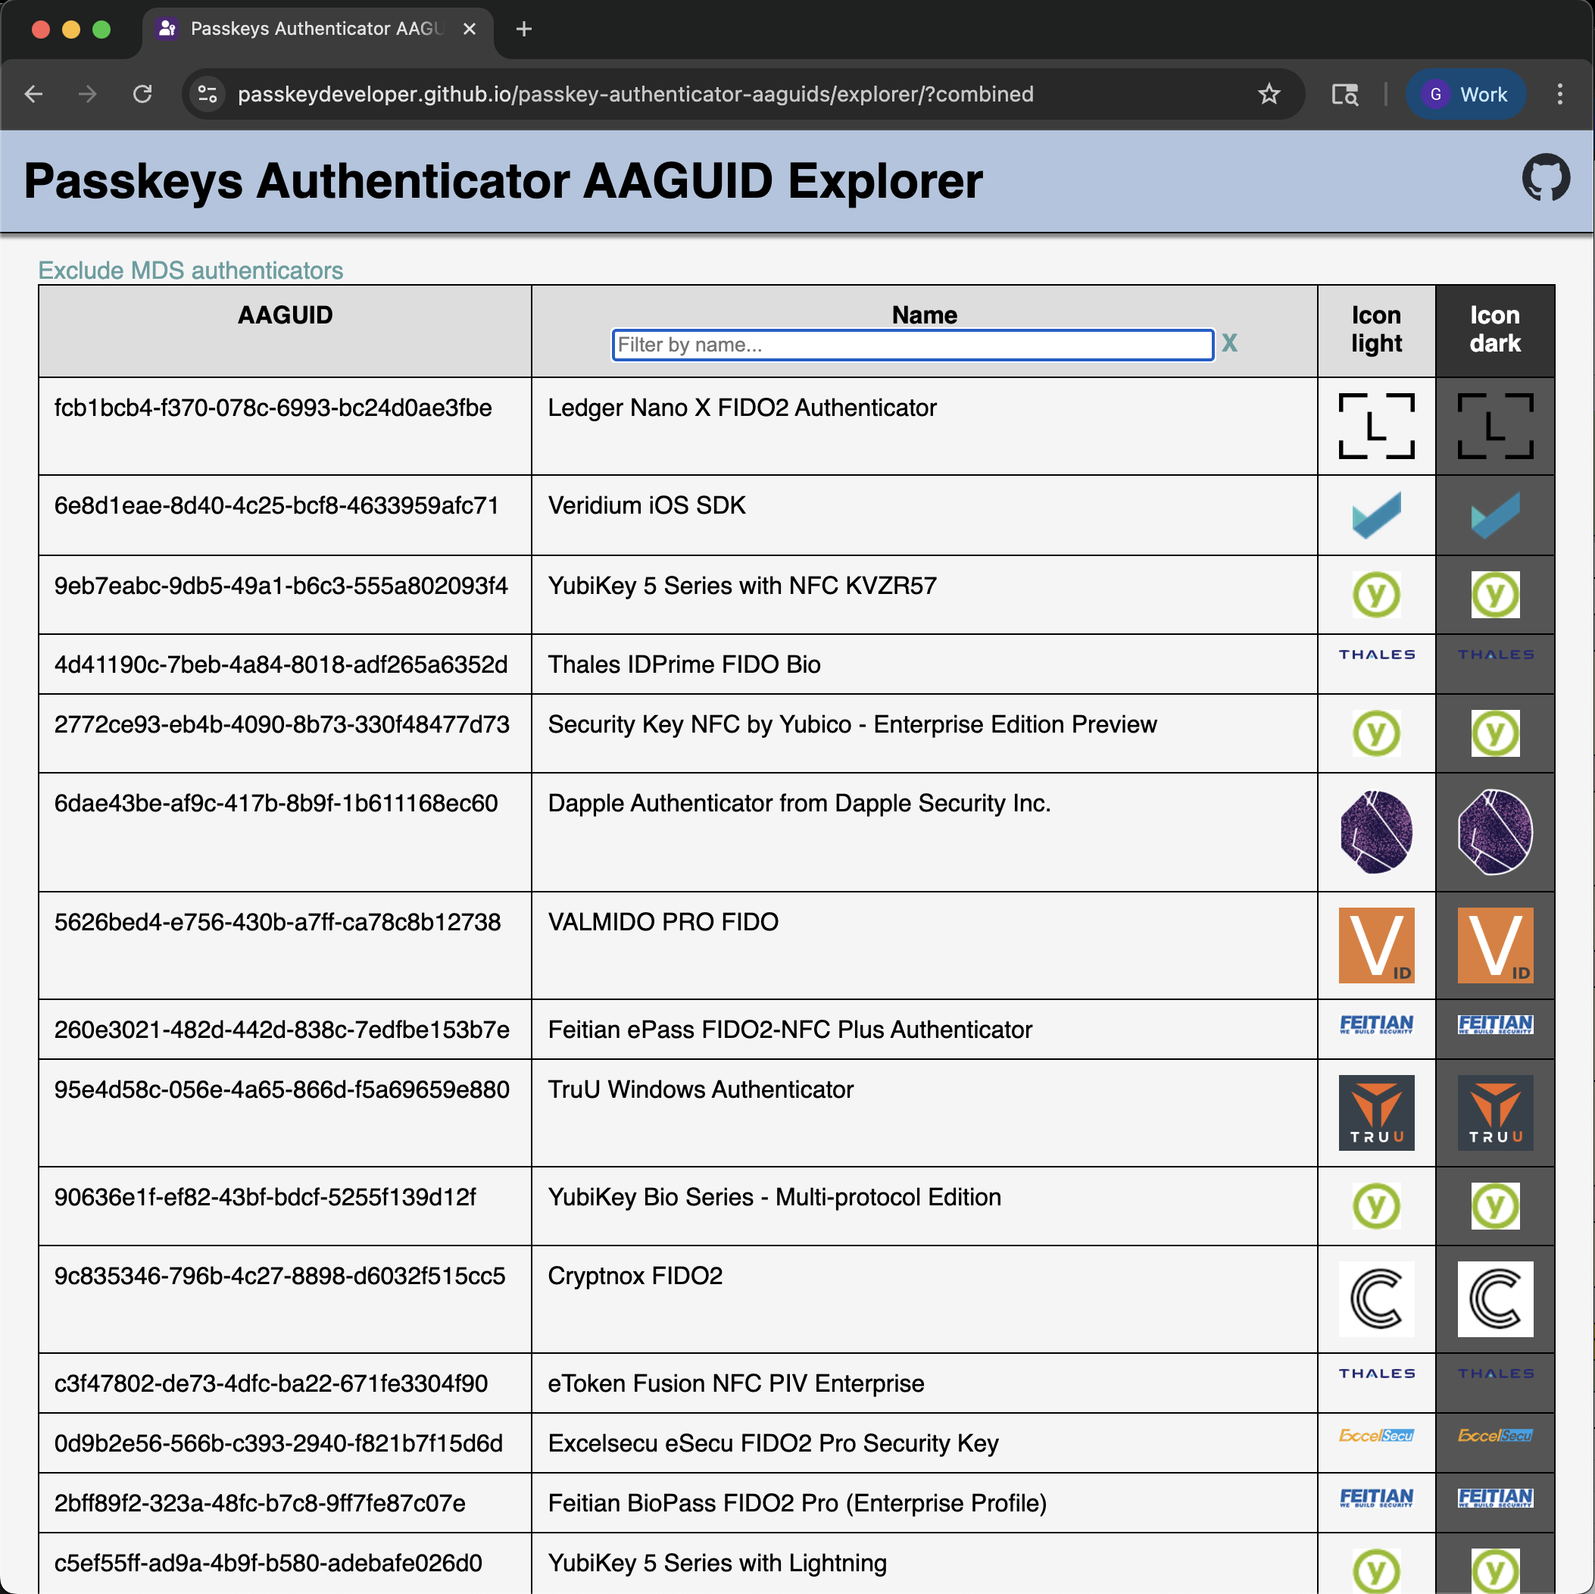
Surveying FIDO2 deployments in the wild
How are they using WebAuthn?
Phase 1: Detailed fact finding
Use Metadata Service resources to catalog authenticators?
The MDS itself is useful, but there are certain authenticators that are not listed
A community resource has popped up that tracks those as well as the MDS authenticators
https://passkeydeveloper.github.io/passkey-authenticator-aaguids/
Notes:
https://github.com/passkeydeveloper/passkey-authenticator-aaguids

Slide 62
Surveying FIDO2 deployments in the wild
How are they using WebAuthn?
Phase 1: Detailed fact finding
Tellingly, the set of non-MDS authenticators is essentially a list of password managers
Google Password Manager
Chrome on Mac
Windows Hello
iCloud Keychain (Managed)
Dashlane
1Password
NordPass
Keeper
Sésame
Enpass
Chromium Browser
Edge on Mac
IDmelon
Bitwarden
iCloud Keychain
Samsung Pass
Thales Bio iOS / Android SDK
Thales PIN iOS / Android SDK
Proton Pass
KeePassXC
ToothPic Passkey Provider
iPasswords
Zoho Vault
LastPass
Devolutions
LogMeOnce
Kaspersky Password Manager
pwSafe
Microsoft Password Manager
initial

Slide 63
Surveying FIDO2 deployments in the wild
How are they using WebAuthn?
Phase 1: Detailed fact finding
Look at actual websites and catalog the details of WebAuthn working
There are several (partially) useful resources for this
Several password manager companies have lists
https://www.keepersecurity.com/passkeys-directory/
https://www.passkeys.io/who-supports-passkeys
https://passkeys.directory/
https://www.passkeys.com/websites-with-passkey-support-sites-directory

Slide 64
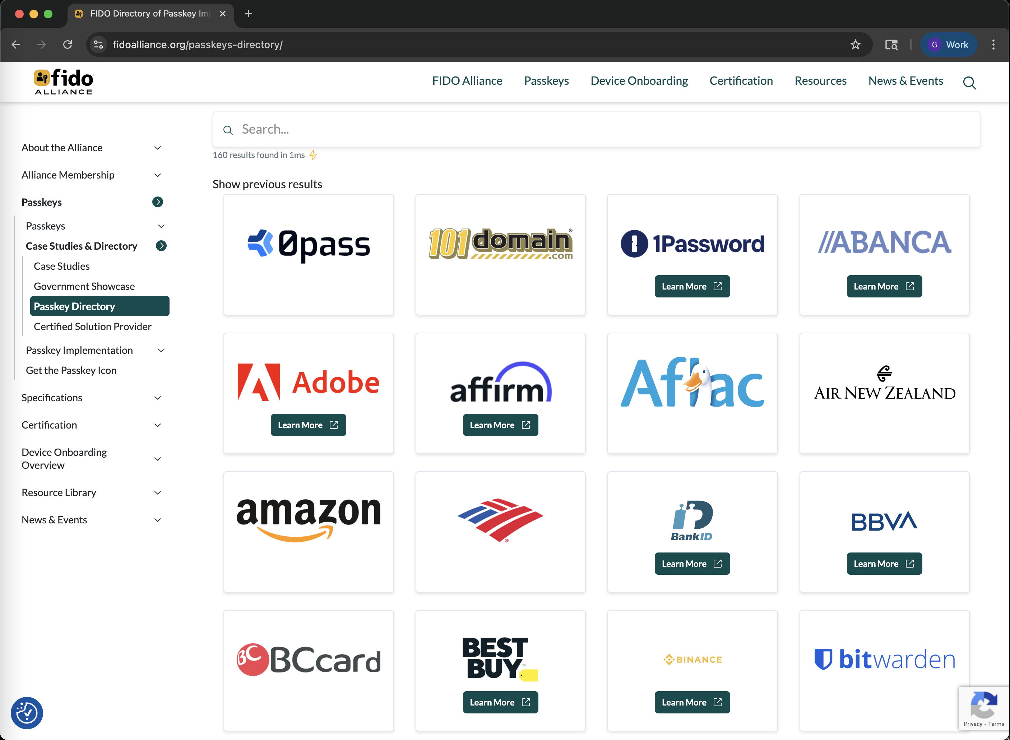
Surveying FIDO2 deployments in the wild
How are they using WebAuthn?
Phase 1: Detailed fact finding
Look at actual websites and catalog the details of WebAuthn working
There are several (partially) useful resources for this
The FIDO Alliance has a list
https://fidoalliance.org/passkeys-directory/

Slide 65
Surveying FIDO2 deployments in the wild
How are they using WebAuthn?
Phase 1: Detailed fact finding
Should I scan the internet for FIDO Servers myself?
This may be the only way to find public-facing enterprise implementations
What API routes do I need to look for in web apps?

Slide 66
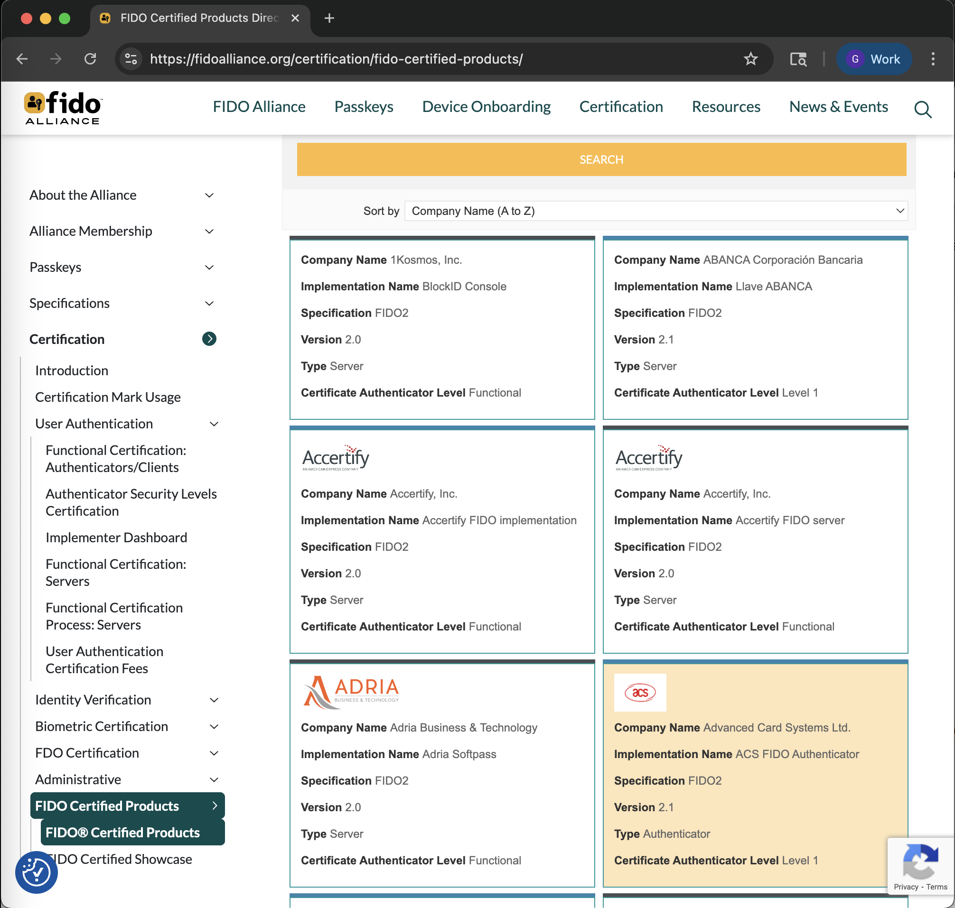
Surveying FIDO2 deployments in the wild
How are they using WebAuthn?
Phase 1: Detailed fact finding
Fingerprinting FIDO Servers
Use the FIDO Alliance list of certified products to enumerate server implementations
Fingerprint implementations using e.g. defined API routes
https://fidoalliance.org/certification/fido-certified-products/

Slide 67
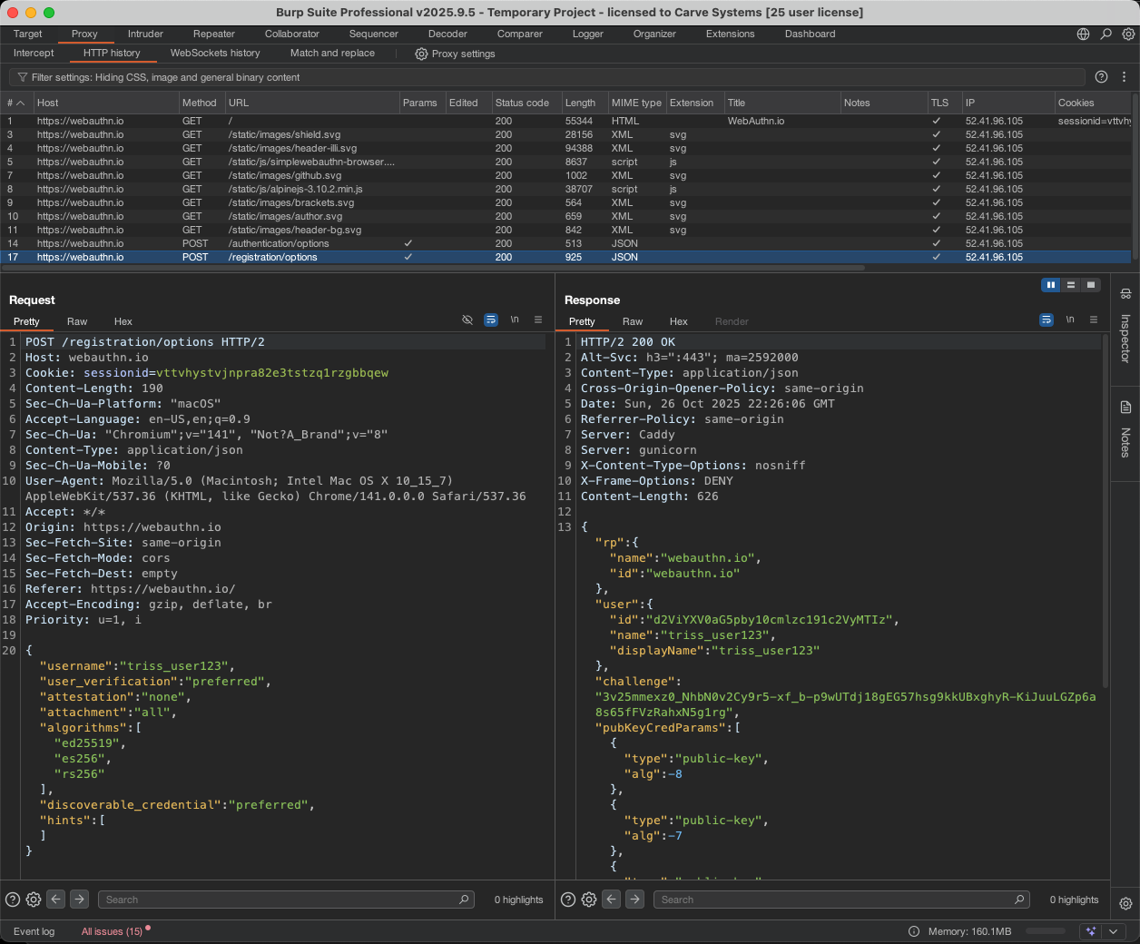
Surveying FIDO2 deployments in the wild
How are they using WebAuthn?
Phase 1: Detailed fact finding
Put these three lists together
Scrape attestation information from known, fingerprinted FIDO Servers
Map the popularity of various authenticator attributes
A work in progress
Anecdotal evidence:
Consumer sites don’t use attestation
Enterprises use “enterprise attestation”
Notes:
We haven’t introduced “Enterprise Attestation” yet, but will touch on it in the threat model section

Slide 68
Surveying FIDO2 deployments in the wild
Phase 2: … ?
Tools for (future) scripting support:
Authenticator database
FIDO Server database
FIDO Server fingerprinting script
Attestation support scraping script
Server implementation and attestation support database
I will publish these tools on GitHub after this talk
https://github.com/ivision-research

Slide 69
Surveying FIDO2 deployments in the wild
Phase 3: Profit Vulnerabilities
Are there security flaws?

Slide 70
An evolving threat model for FIDO2
5

Slide 71

An evolving threat model for FIDO2
Threats describe potential security issues
What could go wrong
There are always threats present

Slide 72
An evolving threat model for FIDO2
Threats describe potential security issues
What could go wrong
There are always threats present
A realized threat is a vulnerability
Something that is an exploitable flaw right now
Notes:
We are talking about threats

Slide 73
An evolving threat model for FIDO2
What could go wrong?
1. Cross-Site Scripting (XSS)
XSS is a type of web security attack where a malicious script is injected into a trusted website and executed by a user's browser.
The Credentials Manager API is vuln to XSS despite best efforts
Github.com / w3c / webappsec-credential-management / #75
Attackers can’t dump private key to JavaScript, but could initiate and intercept a registration or authentication flow
The Credential Manager API put a lot of effort into concealing passwords from the JavaScript of the web page by monkey patching Fetch. This was justified with preventing XSS attacks, but we learned that those attacks are still possible unless the site owner does more work. … Besides that, we received feedback that the API was hard to use.
https://github.com/w3c/webappsec-credential-management/issues/75
Notes:
KEY TAKEAWAY: Some of the same old security issues are still present

Slide 74
An evolving threat model for FIDO2
What could go wrong?
2. Clickjacking
Clickjacking is a malicious technique where a user is tricked into clicking something different from what they perceive, often by embedding a hidden, transparent webpage inside an innocent-looking one. Attackers use this to trick users into performing unintended actions.
Marek Tóth – DefCON 33 (August 9, 2025)
Similar attack vectors to XSS
The result of my research is that clickjacking is still a security threat, but it's necessary to shift from web applications to browser extensions, which are more popular nowadays (password managers, crypto wallets and others).
https://marektoth.com/blog/dom-based-extension-clickjacking/

Slide 75
An evolving threat model for FIDO2
What could go wrong?
3. Changing Attestation Practices
There is a design flaw (IMHO) in the underlying UAF protocol, because the strong, hardware-base device attestation concept is not being harnessed as originally intended.
Consumer-facing sites are avoiding attestation altogether
Password managers /w sync’d keys are popular and have usability advantages
Enterprises are using “enterprise” attestation and SSO providers
Authenticator OEMs will tailor the device attestation key to suit specific enterprise customers
Exfiltrating and stealing passkeys? Attestation confusion among implementors?
Notes:
KEY TAKEAWAY: relaxing standards mean passkeys can be stolen more easily (but maybe not easily)

Slide 76
An evolving threat model for FIDO2
What could go wrong?
4. Spoofing Authenticator Identities
A compromised attestation key can be used to fully spoof an authenticator, which is a concern for FIDO Servers that are configured for heightened security (enterprises, governments).
Software-based authenticators are particularly vulnerable / fatally flawed
I extracted the attestation key for the REDACTED SDK, available in the iOS App Store
In addition, spoofing password manager identities is trivial
It would be a flaw to rely on these identities to make security decisions
Compromised attestation keys should be revoked via the Metadata Service, but this has never happened
Will this compromised attestation key be revoked? Is this another design flaw in attestation?
Stay tuned!
Notes:
Again, attestation regime seems ill fit to evolving use cases.
REDACTED for responsible disclosure reasons

Slide 77
An evolving threat model for FIDO2
What could go wrong?
5. Passkey Import / Export / Sync
A core tenant of FIDO2 is that private keys never leave a secure authenticator, yet the use of password managers as key stores continues to erode this guarantee.
Sync’d passkeys
CXP and CXF protocols will standardize the import / export of passkeys between providers
Synced passkeys are synced between a user's various devices. The passkeys are stored securely with a password or credential manager such as Apple Passwords, Google Password Manager, 1Password, Dashlane or LastPass. Users can access synced passkeys across many of their devices, even new ones, without having to re-enroll every device on every account.
The FIDO Alliance has published a working draft of a new set of specifications for secure credential exchange that, when standardized and implemented by credential providers, will enable users to securely move passkeys and all other credentials across providers.
https://www.passkeycentral.org/introduction-to-passkeys/passkey-types
https://fidoalliance.org/fido-alliance-publishes-new-specifications-to-promote-user-choice-and-enhanced-ux-for-passkeys/

Slide 78
An evolving threat model for FIDO2
What could go wrong?
6. FIDO Server Misconfiguration
FIDO2 is complicated. FIDO Servers are prone to misconfiguration, especially for use cases that require robust authenticator security.
Complexity is the enemy of security. Misconfiguration may allow users to register insecure authenticators or use authentication methods that are meant to be denied by policy.
Notes:
KEY TAKEAWAY: FIDO2 is complicated, which means implementors and integrators are going to make mistakes

Slide 79
An evolving threat model for FIDO2
What could go wrong?
7. FIDO Server Implementation Flaws
Security bugs in FIDO Server implementations can lead to authentication data exfiltration, server-side request forgery (SSRF), improper credential validation, and bypassing registration or authentication flows.
Evaluating specific FIDO Server implementations is a major area of future work for me.

Slide 80
An evolving threat model for FIDO2
What could go wrong?
8. “Unsolving” passwords
“Mission accomplished: no one can share their passwords anymore. But how do I help my elderly parent? How do I complete tasks on behalf of my children? How do I enact the will and get access to the digital assets of my deceased relatives?”
– Dima Postnikov, Head of Identity Strategy and Architecture, ConnectID
Authenticate Con, October 13, 2025
No matter how insecure, passwords allowed us to avoid solving delegation correctly. Now, we cannot avoid it anymore.
These are problems that will get solved either by working around the spec or adding features that make it even easier to access private keys – for legitimate users and attackers.

Slide 81
In summary
6

Slide 82
In summary
Key Takeaways
FIDO2 was originally intended to support hardware authenticators with strong security guarantees
But these guarantees are being eroded in practice
This makes it easier (but maybe not easy) to steal passkeys
FIDO2 is not magic
Some of the same old security issues are still present
FIDO2 is complicated, which means implementors and integrators are going to make mistakes

